Slide 1

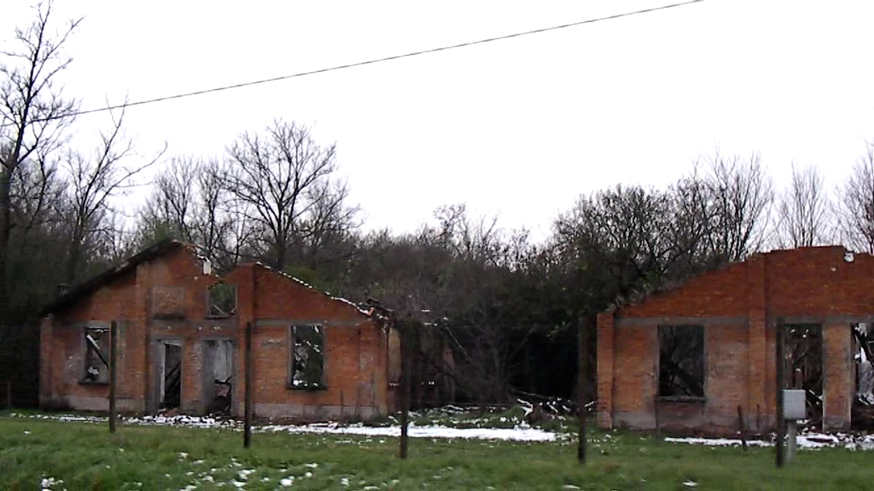


. . . . . .
SIXPOINTS PRODUCTIONS
DONATE
GET INVOLVED
ABOUT
CONTACT
THE NEIGHBOR WITHIN
The Hidden History of Concentration
Camps in Italy
FISCALLY SPONSORED BY:
DONATE
The discrimination faced by Jews in Italy and the 11 Concentration Camps on Italian soil during World War II remain vastly unacknowledged, leaving many in the Italian Jewish communities struggling to keep their history of persecution alive as their memories at times run completely contrary to the official narrative now prevalent in Italian society.
Help us tell their story.
Please make a TAX DEDUCTIBLE DONATION to
the National Center for Jewish Film.
“…A most important project.”
- Steven Spielberg Jewish Film Archives

